Slide 1
ClearTrace facts, not fakes

Slide 2
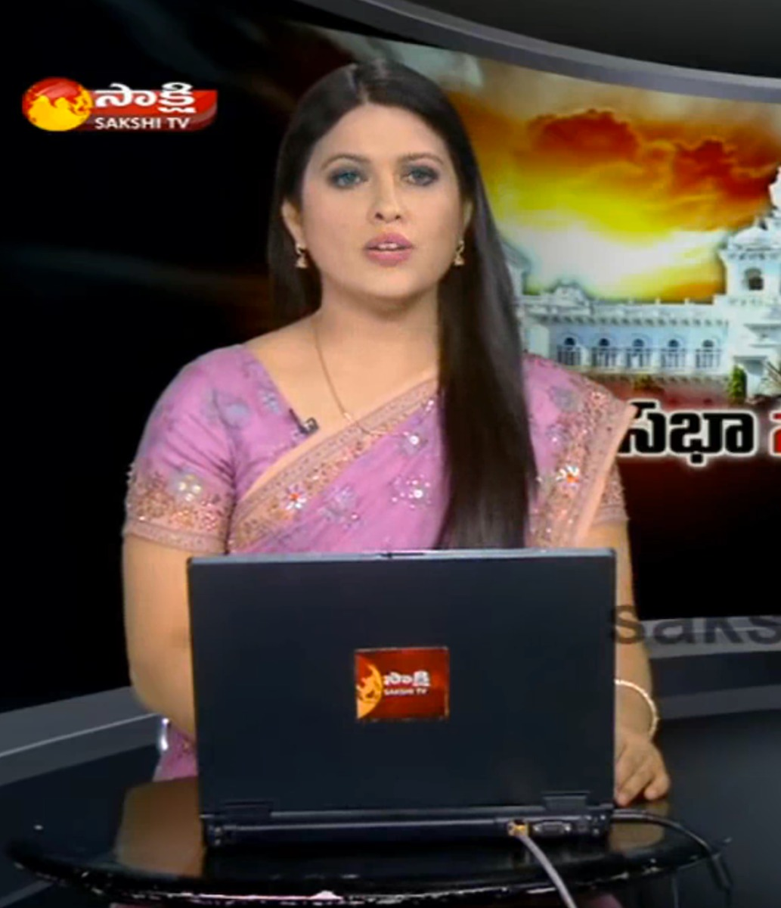
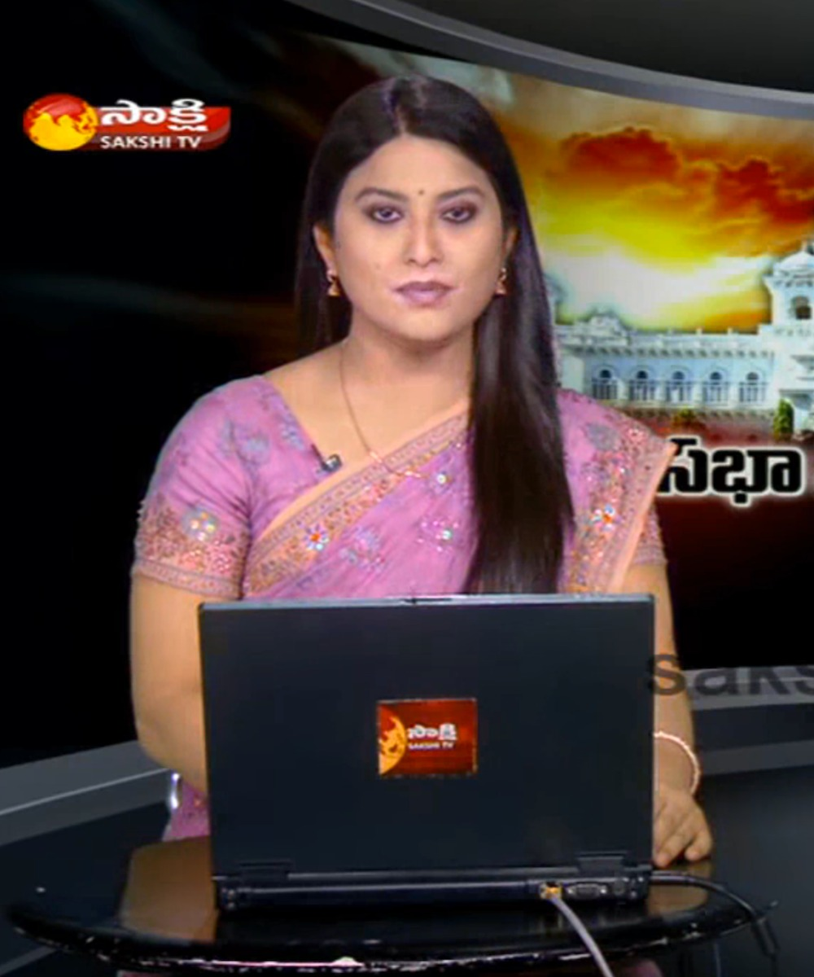
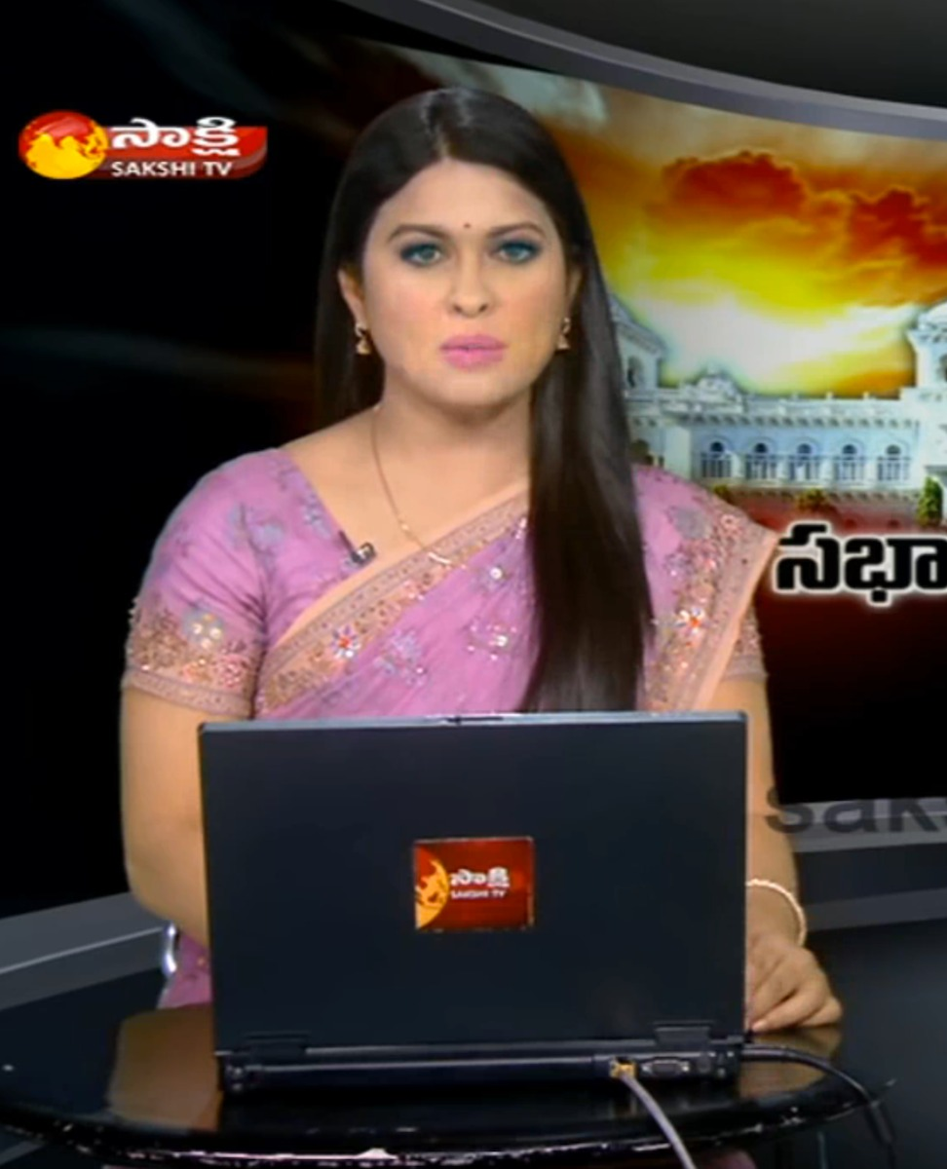
Who said fake news?

Slide 3




Detection Models
Public
Solution

Slide 4

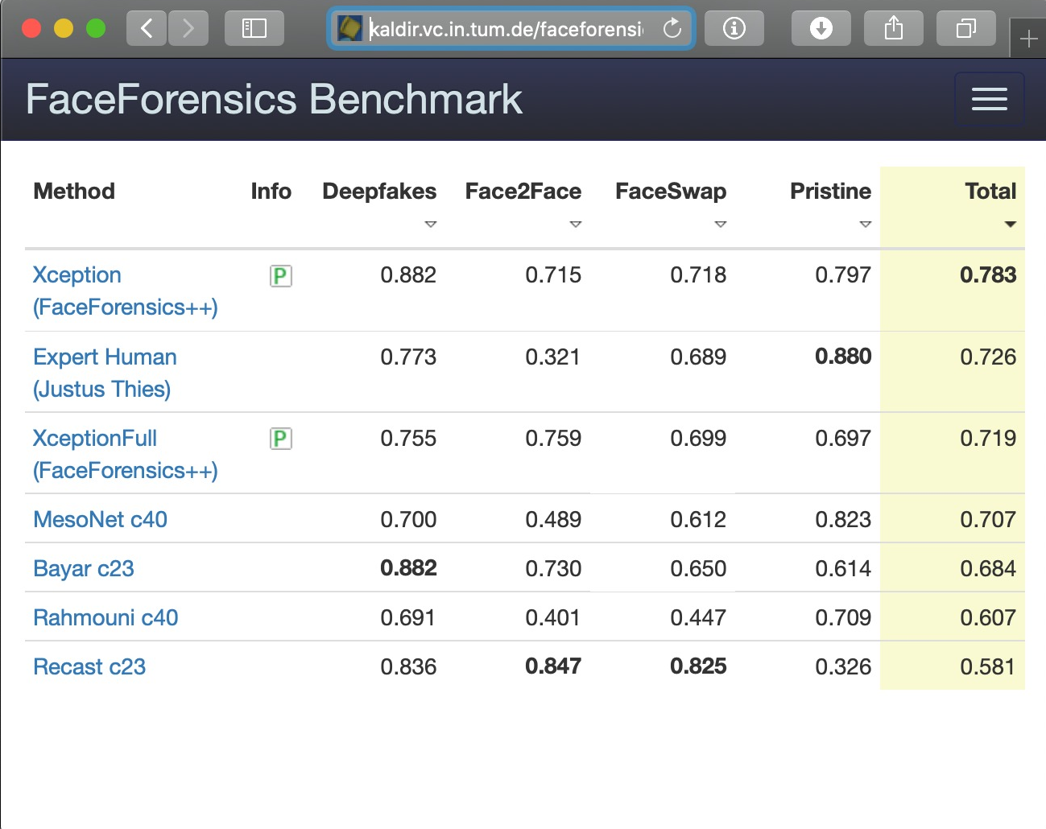
Benchmark

Slide 5
Pipeline

Slide 6
Video analysis model

Slide 7
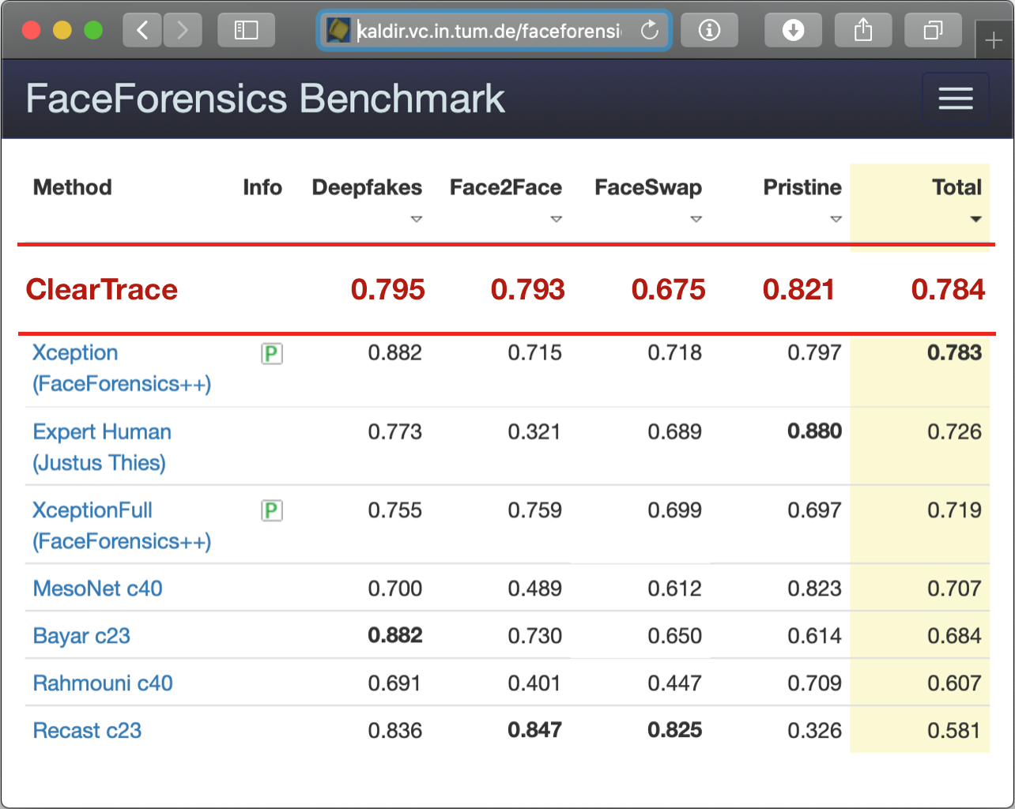
Benchmark v2

Slide 8






Users
Authorities
Content
Providers

Slide 9

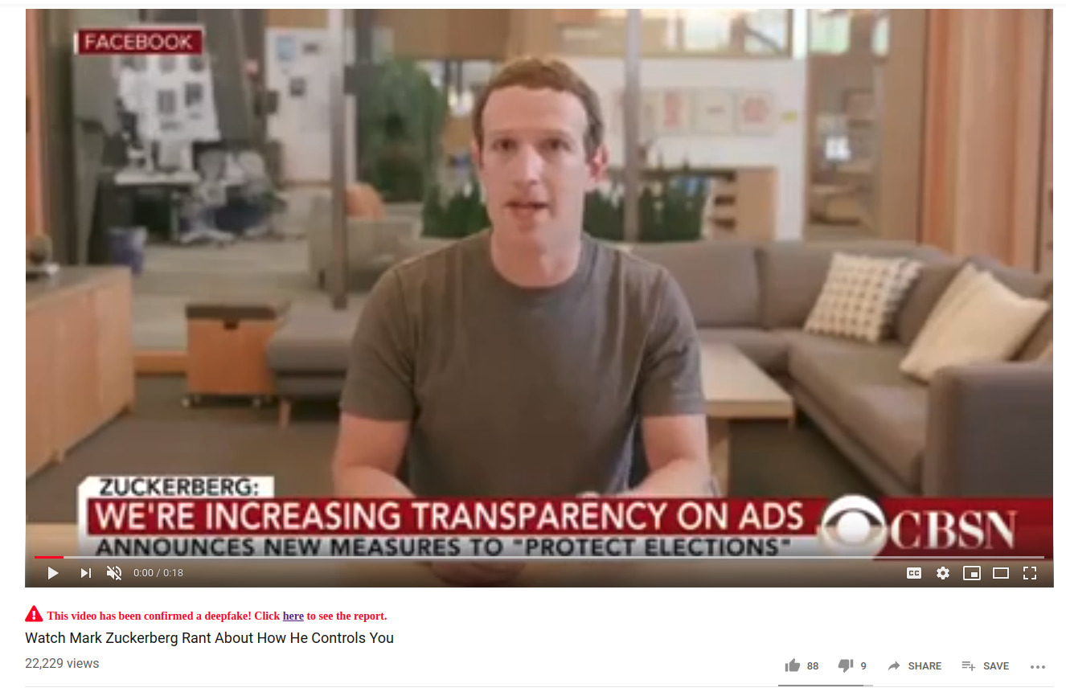
Notification

Slide 10
Notification

Slide 11
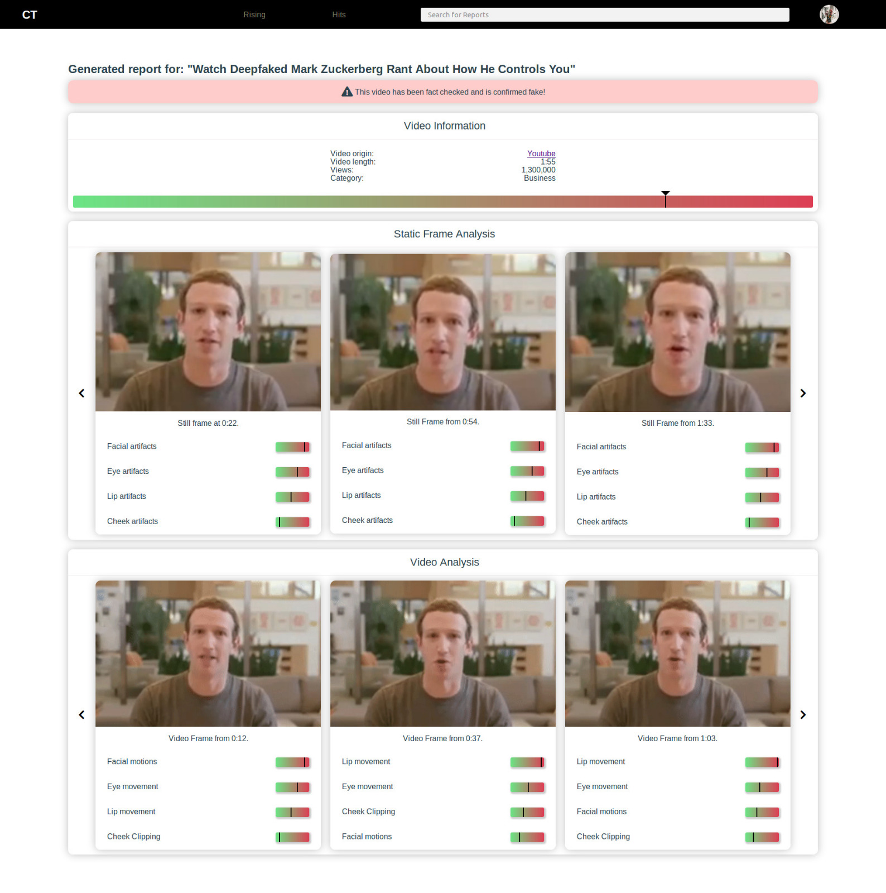
Report

Slide 12
Report

Slide 13



Wrap up
Developments
Goals
Detect
Detection Models
Inform
Public
Solution
Track

Slide 14
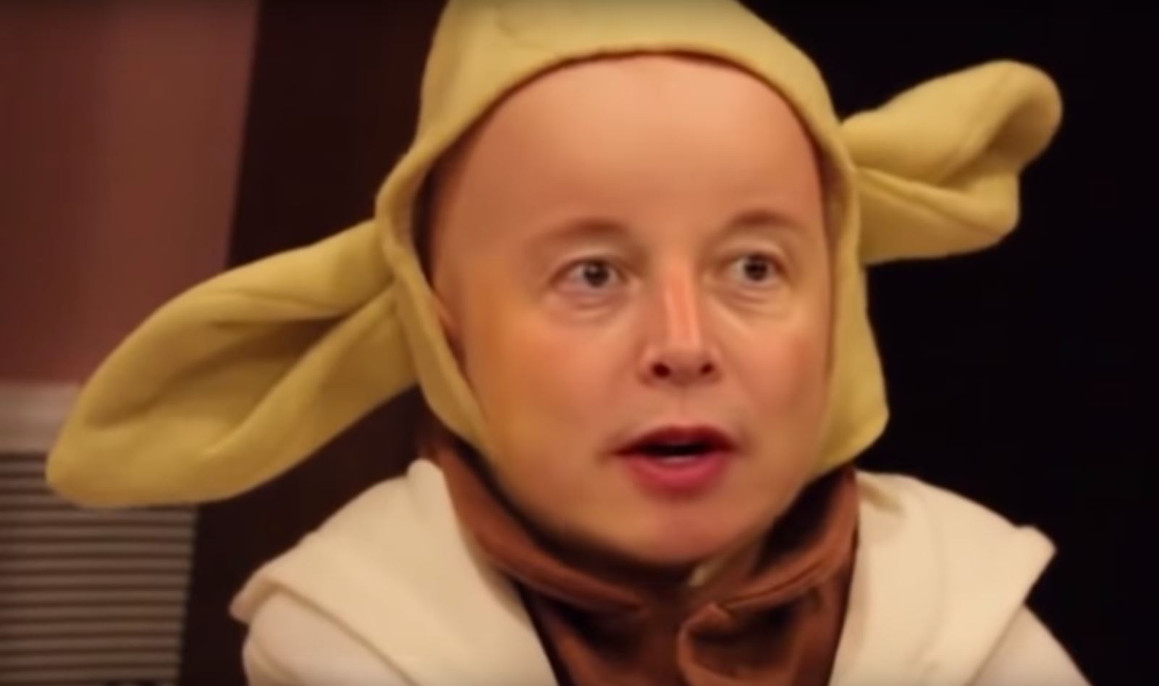
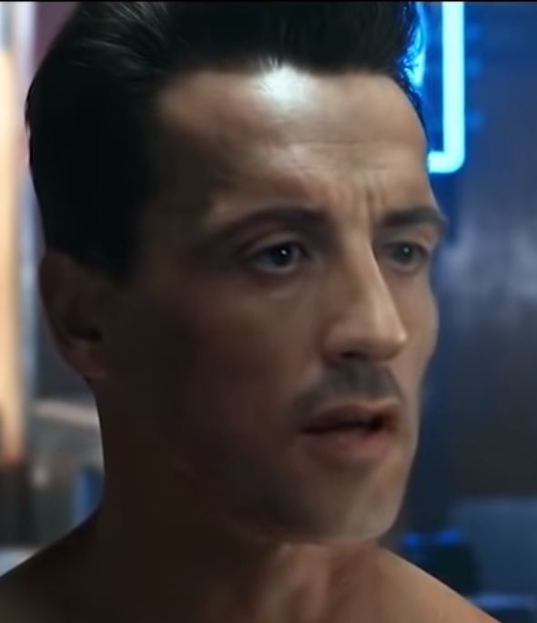
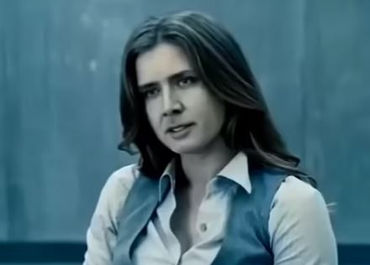
Let them be …

Slide 15
ClearTrace facts, not fakes

